Slide 1

Title:
Emotion-Based Music Recommendation System Using Deep Learning, Computer Vision.
batch - 3
Rollno: 2300520025
Rollno: 2300520031
Rollno: 2300520141
Project Guide : DR.madhavrao

Slide 2

Objective
Detect the user's emotions using facial expressions.
Use deep learning to classify emotions.
Recommend music based on the detected emotion.
Automate the process using computer vision.
This Photo by Unknown Author is licensed under CC BY-SA

Slide 3
Abstract:
This project is an intelligent music recommendation system that uses facial expressions to suggest songs. By analyzing emotions like happiness, sadness, or anger through real-time facial recognition, the system recommends music in Telugu and Hindi based on the user’s mood, preferred language, and favorite artists. It integrates deep learning for emotion detection, machine learning for recommendations, and a seamless frontend-backend architecture to enhance the user experience. The system provides a personalized and emotion-driven way to enjoy music.
This Photo by Unknown Author is licensed under CC BY-SA

Slide 4
INTRO
Music affects emotions and enhances mood.
Emotion-based recommendation systems improve user experience.
Uses Deep Learning & Computer Vision to detect emotions and suggest songs.
Goal: Automatically recommend music based on facial emotions.
This Photo by Unknown Author is licensed under CC BY-SA

Slide 5
Exsiting Challenges:
Real-Time Emotion Detection: Ensuring accurate and low-latency emotion detection using facial expressions, even in varying lighting conditions, angles, and facial features.
Emotion-to-Music Mapping: Designing a robust algorithm to effectively map detected emotions to appropriate songs in Telugu and Hindi, considering cultural and regional music preferences.
Frontend-Backend Integration:
Achieving seamless communication between the dynamic user interface and backend systems to deliver real-time recommendations without delays.
This Photo by Unknown Author is licensed under CC BY-SA

Slide 6
Problem Statement
Existing music players require manual song selection.
Users may struggle to find suitable songs for their mood.
Need for an automated system that understands emotions and plays appropriate music.
This Photo by Unknown Author is licensed under CC BY-SA

Slide 7
Technologies:
Frontend & User Interaction:
ipywidgets: For creating interactive elements.
Matplotlib: For displaying images.
Computer Vision & Emotion Detection:
OpenCV: For image processing.
Dlib: For facial landmark detection.
FER: For facial emotion recognition.
Music Recommendation:
Spotipy: For interacting with the Spotify API to recommend music based on emotion.
Deep Learning:
TensorFlow (indirectly via FER) for emotion detection.
This Photo by Unknown Author is licensed under CC BY-SA

Slide 8
Proposed System:
HarmonyLink is an AI-powered music recommendation system that interlinks multiple streaming platforms (Spotify, YouTube, etc.) and consolidates mood-based playlists from different sources into one intelligent recommendation engine.Instead of relying on a single database of songs, HarmonyLink dynamically fetches playlists from multiple services and creates a personalized, mood-driven music experience across platforms.

Slide 9
LITERATURE SURVEY
1. Emotion Recognition from Facial Expressions using CNN Source: Mollahosseini et al., "AffectNet: A Database for Facial Expression, Valence, and Arousal Computing in the Wild"
This study introduced a large-scale facial emotion dataset and used deep convolutional neural networks (CNNs) to achieve high accuracy in real-time emotion classification, forming the foundation for emotion-driven applications like music recommendation.

Slide 10
2. Deep Learning for Music Recommendation based on User Emotions Source: Soleymani et al., "Emotion-aware Music Recommendation using Content-based Filtering"
The research demonstrated how integrating user emotional states with music features (like tempo and lyrics) improved recommendation quality, highlighting the impact of affective computing in personalized music systems.

Slide 11
3. Real-Time Emotion Detection from Webcam Input using OpenCV and FER2013 Source: Goodfellow et al., “Challenges in Representation Learning: A Report on Three Machine Learning Contests”
This paper discussed using the FER-2013 dataset and deep learning architectures like CNN for facial emotion recognition from images, providing real-time classification for human-computer interaction tasks.

Slide 12
4. Hybrid Recommender Systems using Emotion and Contextual Data Source: Ekstrand et al., "Collaborative Filtering Recommender Systems"
The research explored combining emotion recognition with collaborative filtering to generate music suggestions that adapt to the user's mood, location, and time of day, enhancing system responsiveness.

Slide 13
5. AI-Driven Music Personalization using Multimodal Inputs Source: Kim et al., “DeepMood: Modeling Mobile Phone Typing Dynamics for Mood Detection”
Although originally about mood detection from typing, this work emphasized how multimodal data (facial expressions, behavioral cues) could be fused using deep models (LSTM, CNN) for accurate emotion prediction and personalized content delivery like music.

Slide 14
System Architecture
Capture Image: Webcam captures user’s face.
Emotion Detection: CNN-based model identifies emotions (happy, sad, angry, etc.).
Music Database: Predefined playlists mapped to emotions.
Song Recommendation: System plays a song based on detected emotion.
This Photo by Unknown Author is licensed under CC BY-SA

Slide 15
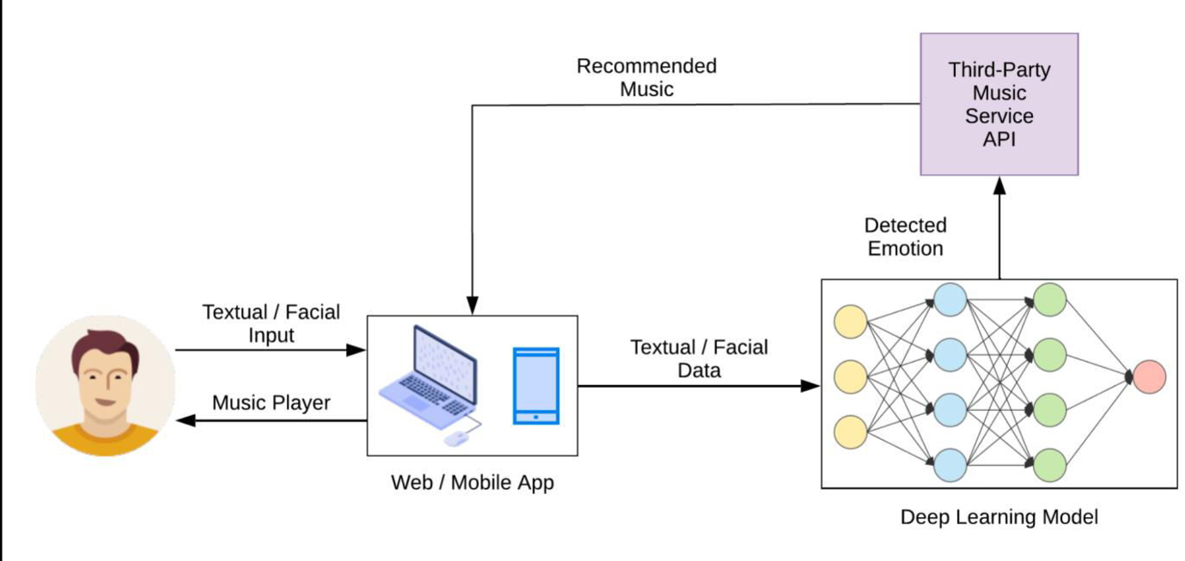
ARchitecture

Slide 16
MODULES
1. Opencv - for capturing the face
2. Dilib - for facial feature identification
3. Fer - facial emotion recognition
4. Tensor Flow - improve the accuracy of the above image
5. Spotify Apl - Music Recommendation
6. Matplot Lib - for Button Access

Slide 17
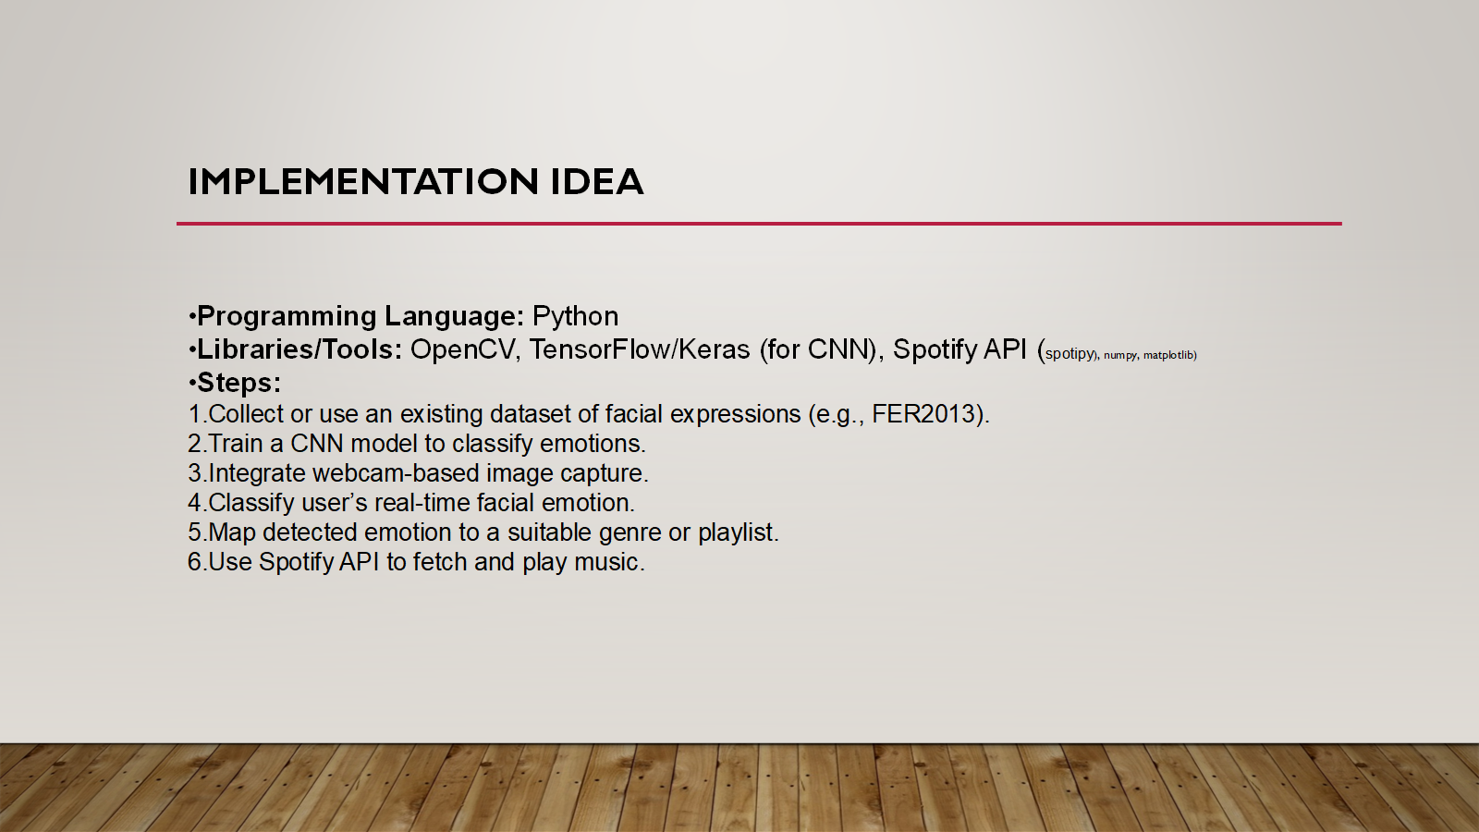

Slide 18

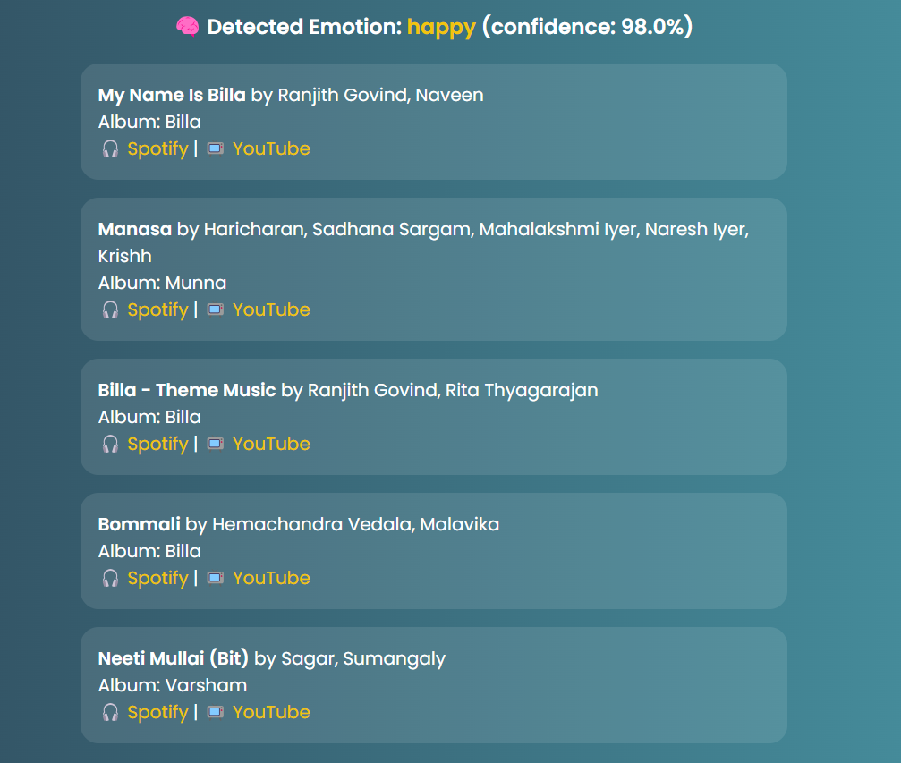
OUTPUT - 1

Slide 19

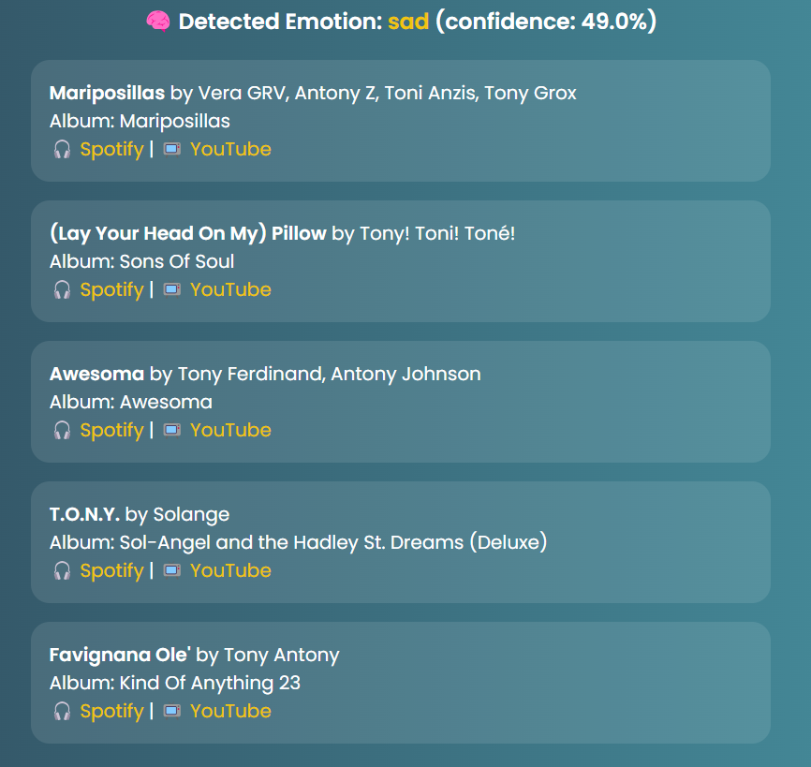
OUTPUT - 2

Slide 20
Conclusion
This project is an emotion-based music recommender system that uses a webcam to detect the user's facial expression and suggests songs based on their mood. It combines facial emotion recognition with the Spotify API to recommend music that matches how the user feels.
The system works well and gives a personalized music experience. It shows how technology can be used to connect emotions with music in a smart and useful way.

Slide 21
FUTURE WORK
Live Emotion Detection Instead of just capturing one image, use live video from the webcam to detect emotions continuously and update music suggestions in real time.
Better Emotion Detection Use not just facial expressions, but also voice, body posture, or text input to understand the user’s mood more accurately.
Personalized Music Use the user’s past activity, likes, and feedback to give better music suggestions and create custom playlists based on their mood.
Mobile App Make a mobile version of the app using tools like Flutter or React Native so it can be used on phones and tablets.
Smarter Models Use more powerful and accurate AI models like CNNs or Transformers to detect emotions better, even in different lighting or angles.
Language Support Add support for more languages so users can get music suggestions in their local or preferred language using Spotify’s international options.

Slide 22
REFERENCES
[1] A. Mollahosseini, B. Hasani, and M. H. Mahoor, “AffectNet: A Database for Facial Expression, Valence, and Arousal Computing in the Wild,” IEEE Transactions on Affective Computing, vol. 10, no. 1, pp. 18–31, Jan.-Mar. 2019.
[2] I. Goodfellow et al., “Challenges in Representation Learning: A Report on Three Machine Learning Contests,” Neural Networks, vol. 64, pp. 59–63, Apr. 2015.
[3] M. Soleymani, M. N. Caro, and G. Chanel, “Emotion-Aware Music Recommendation Using Content-Based Filtering,” in Proc. of the 2014 IEEE Int. Conf. on Multimedia and Expo Workshops, Chengdu, 2014, pp. 1–6.
[4] J. Kim, S. M. Lee, and R. W. Picard, “DeepMood: Modeling Mobile Phone Typing Dynamics for Mood Detection,” in Proc. of the 20th ACM Int. Conf. on Multimodal Interaction, Boulder, CO, 2018, pp. 211–218.
[5] M. Ekstrand, J. T. Riedl, and J. A. Konstan, “Collaborative Filtering Recommender Systems,” Foundations and Trends in Human–Computer Interaction, vol. 4, no. 2, pp. 81–173, 2011.

Slide 23
[6] T. Baltrušaitis, P. Robinson, and L. P. Morency, “OpenFace: An Open Source Facial Behavior Analysis Toolkit,” in IEEE Winter Conference on Applications of Computer Vision (WACV), Lake Placid, 2016, pp. 1–10.
[7] D. P. Kingma and J. Ba, “Adam: A Method for Stochastic Optimization,” in Proc. of the 3rd Int. Conf. on Learning Representations (ICLR), San Diego, CA, 2015.
[8] K. Simonyan and A. Zisserman, “Very Deep Convolutional Networks for Large-Scale Image Recognition,” in Proc. of the Int. Conf. on Learning Representations (ICLR), 2015.
[9] T. Chen, H. Fang, and Y. Lin, “Music Recommendation System Based on Convolutional Neural Network and Emotion Recognition,” Journal of Physics: Conf. Series, vol. 1601, 2020.
[10] Y. Zhang and Q. Yang, “An Overview of Multi-Task Learning in Deep Neural Networks,” National Science Review, vol. 5, no. 1, pp. 30–43, 2018.

Slide 24

Thank You

